Slide 1

Let WebScout be on the watch for you.

Slide 2
Our services
Penetration testing
Cloud encryption for your data
Local security (firewall and anti-virus)

Slide 3
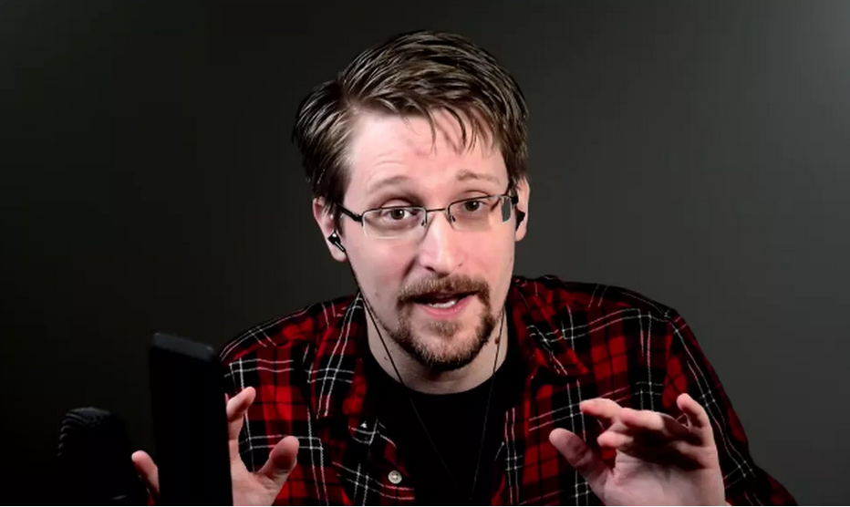
Approved by Ed
I trust WebScout!

Slide 4

The joke
A tcp packet walks in to a bar and says “I want a beer”, barman says “you want a beer?” and tcp packet says “yes, a beer”.
Then the UDP packet walks into the bar and do not ask anything, he just says « I’m gonna drink the beer », and then he drink the drink the beer.

